Slide 1

Waterfall Week 2 Presentation

Slide 2
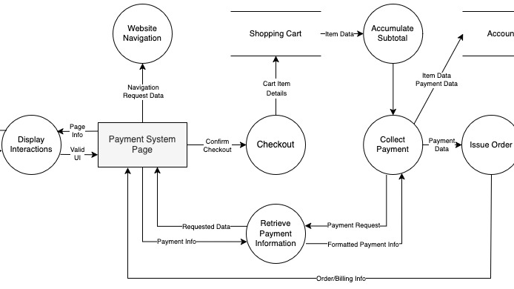
Design

Slide 3
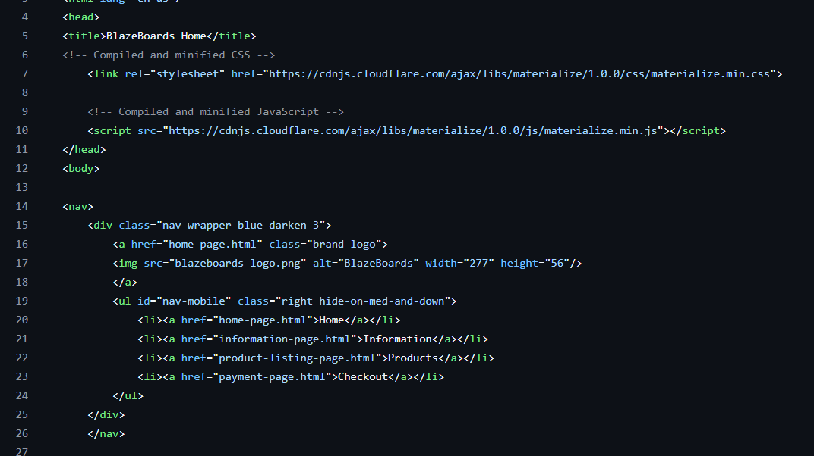
Implementation

